Slide 1
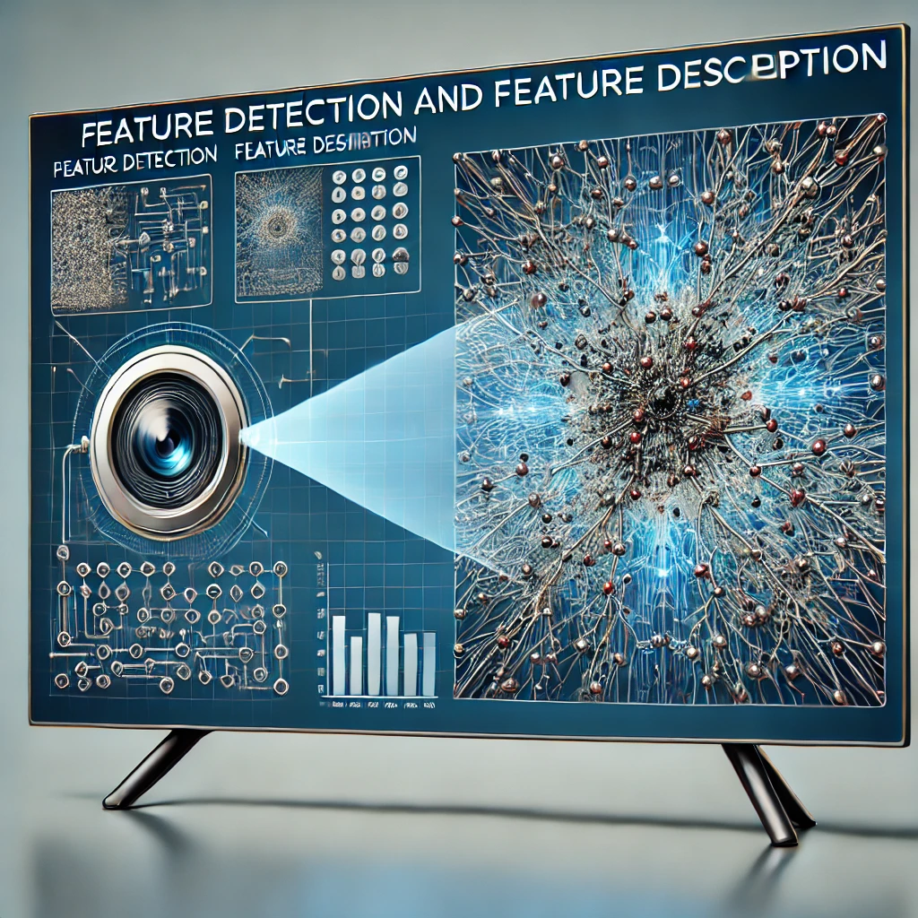
Object / Feature Detection and Description
Instructor: Stephin Rachel Thomas
29-01-2026

Slide 2

Today’s Topics
Segmentation and Binary Images
Basic and Adaptive threshold
Introduction to Contours
Introduction to Feature Detection
Basic concept of Feature Detection
Image Gradient
Scale Invariant Feature Transform (SIFT)
Speeded Up Robust Features (SURF)
Advanced Feature Detection Techniques
Feature Descriptors
Feature Matching and Applications
Machine Learning in Feature Detection
Future trend in Feature Description

Slide 3
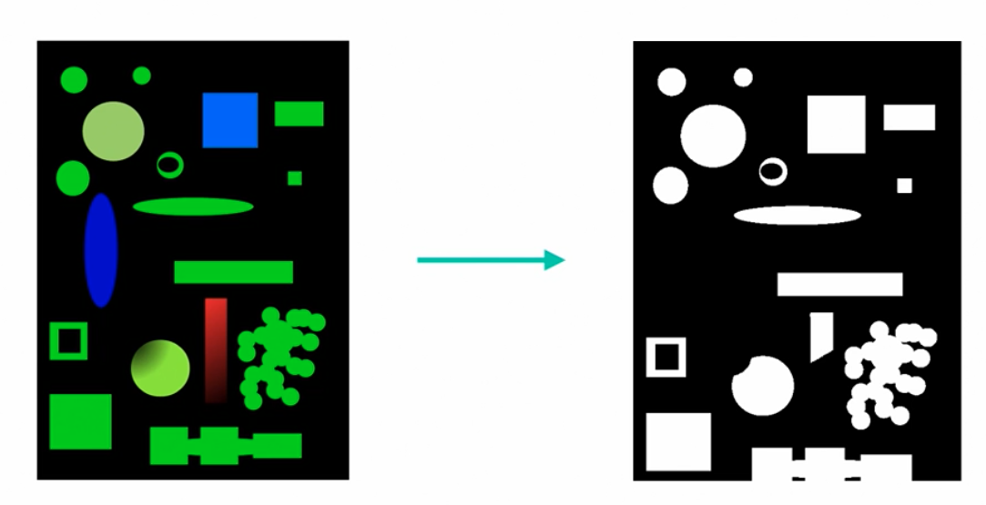
Segmentation and Binary Images
Segmentation – Extracts objects from image for further processing
Output of segmentation is typically a binary image –Image with values of zero and one(black and white)
1 indicates the piece of image we wanted to use and 0 indicates everything else.
Binary image is key component of many image processing algorithms, and it acts as a mask for the area of the source image
One of the typical way to get a binary image is to use thresholding algorithm
Thresholding is a type of segmentation that looks at the values of the source image and perform a comparison against one central value to decide whether a single pixel or group of pixels should have a value of zero or one.

Slide 4
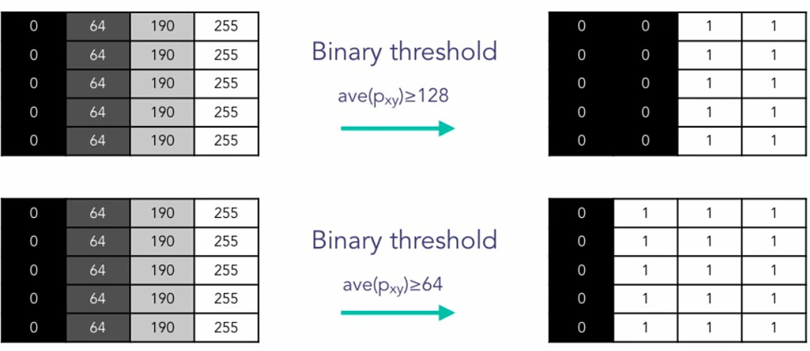
Segmentation and Binary Images

Slide 5
Hands on Exercise

Slide 6
Adaptive Thresholding
Binary thresholding is not ideal for events such as uneven lighting, adaptive thresholding is a solution
Instead of taking a simple global value as a threshold comparison, adaptive thresholding will use its local neighborhood of the image to determine whether a relative threshold is met, thus counteract issues like uneven lighting.
It calculates threshold value for each sub regions instead of the whole image
Adaptive methods - adaptive_mean or adaptive_gaussian

Slide 7
Hands on Exercise

Slide 8
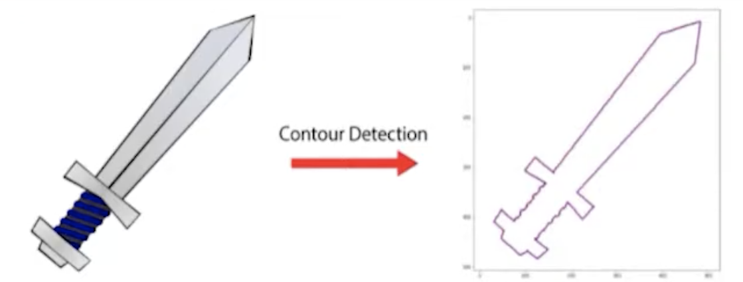
Introduction to Contours
A contour is a curve that joins a set of points enclosing an area having the same color or intensity.
The area of uniform color or intensity forms the object that we are trying to detect and the curve enclosing this area is the contour representing the shape of the object.
It works similar to edge detection but with the restriction that the edges detected must form a closed path
Contours defines boundaries of objects in an image
Useful for shape analysis, object detection and recognition.
The output of segmentation (binary image) is used as input for contour detection(pre-processing)

Slide 9

Contour Object Detection
Cv2.findContours() - OpenCV built in function for finding contours in an image.
This method returns:
Contours – A list of contours in the image. Each contour is a vector of boundary points
Hierarchy – optional output vector containing information about image topology (parent-child relationship)

Slide 10
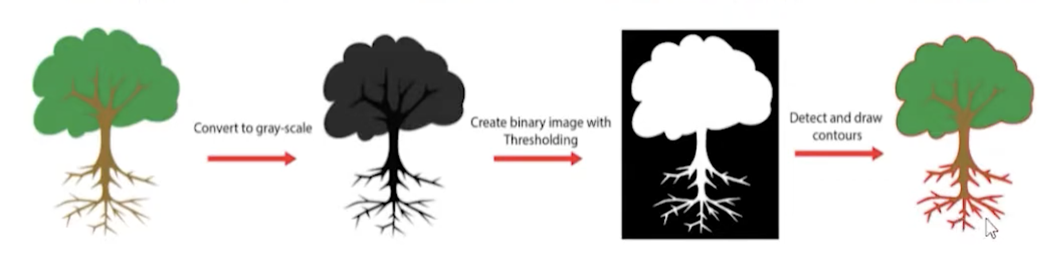
Contour Object Detection
Cv2.drawContours() - The function draws contour outlines in the image if 𝚝𝚑𝚒𝚌𝚔𝚗𝚎𝚜𝚜≥0 or fills the area bounded by the contours if 𝚝𝚑𝚒𝚌𝚔𝚗𝚎𝚜𝚜<0

Slide 11
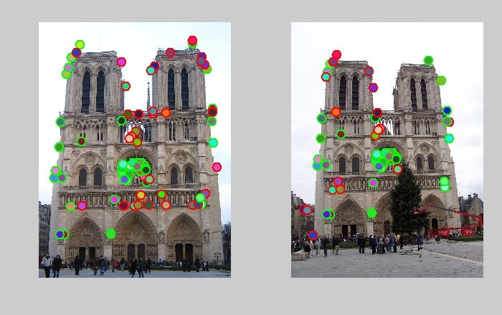
Introduction to Feature Detection
Definition: It is the process of identifying and locating significant structures or patterns within an image.
These features are crucial for understanding and interpreting visual information in tasks such as object recognition, motion tracking, and image classification.
A feature is an interesting part of an image
Examples: Edges (sharp changes in intensity), Corners (intersection of two edges), Blobs (regions of similar texture or color), and Ridges (lines of high intensity).

Slide 12
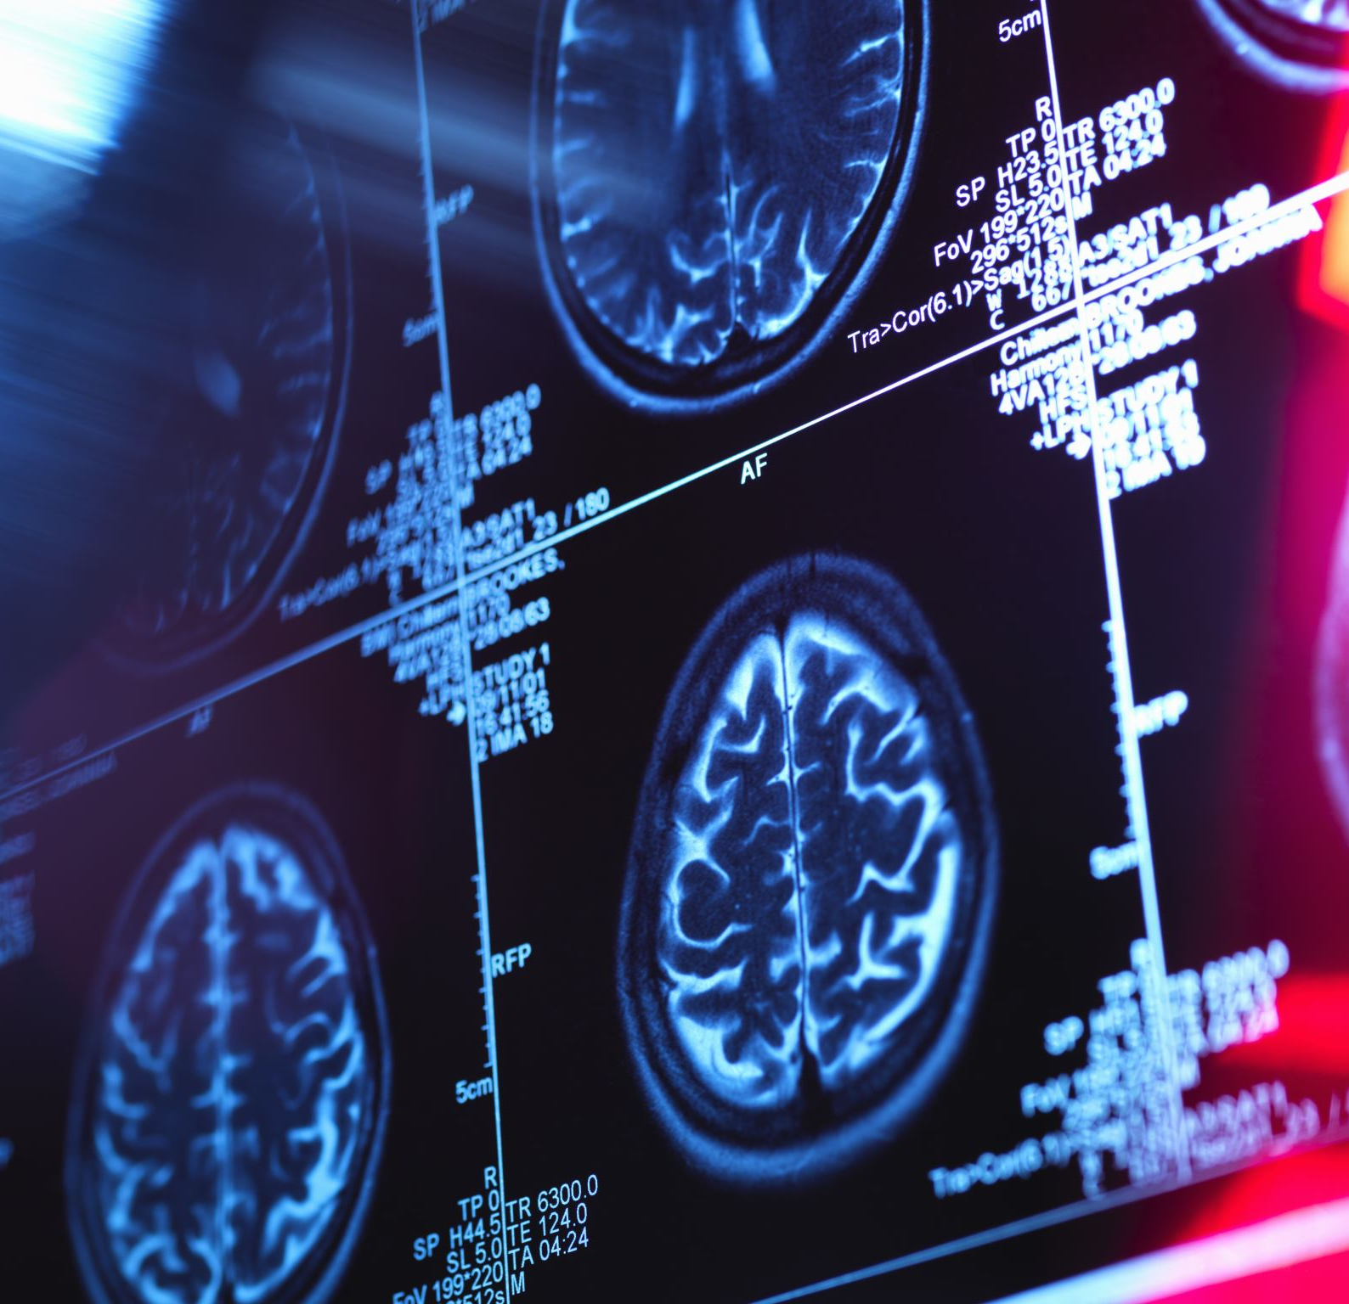
Historical Context and Importance
Feature detection has evolved significantly since the early days of computer vision.
Early techniques focused on simple edge detection, while modern approaches leverage complex algorithms and deep learning.
Applications span various domains including –
Autonomous vehicles (for navigation and obstacle detection),
Medical imaging (for disease diagnosis),
Augmented reality (for enhancing real-world environments with digital overlays).

Slide 13
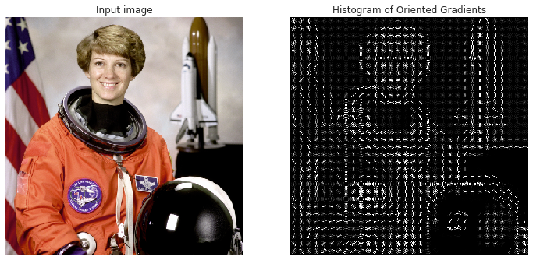
Basic Concepts of Feature Detection
Understanding Image Gradients: Gradients measure directional changes in the intensity
or color of an image and are fundamental in identifying features.

Slide 14
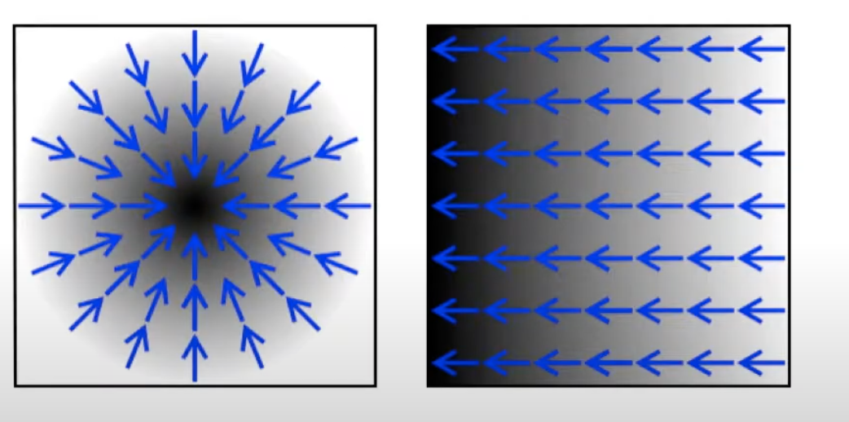
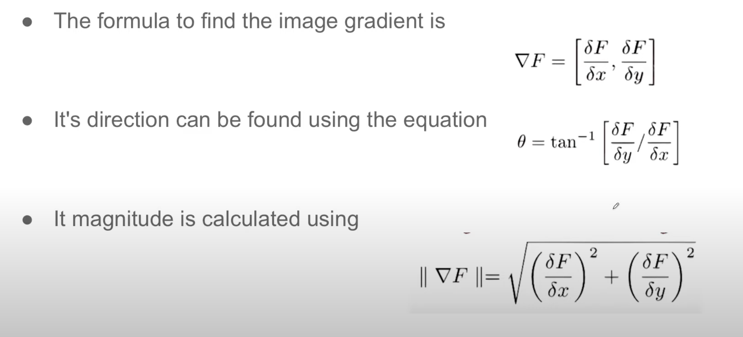
Image Gradient
Measure of change in Image function F(x,y) in X or Y direction
Change in color represents magnitude and the blue arrows represent the direction

Slide 15
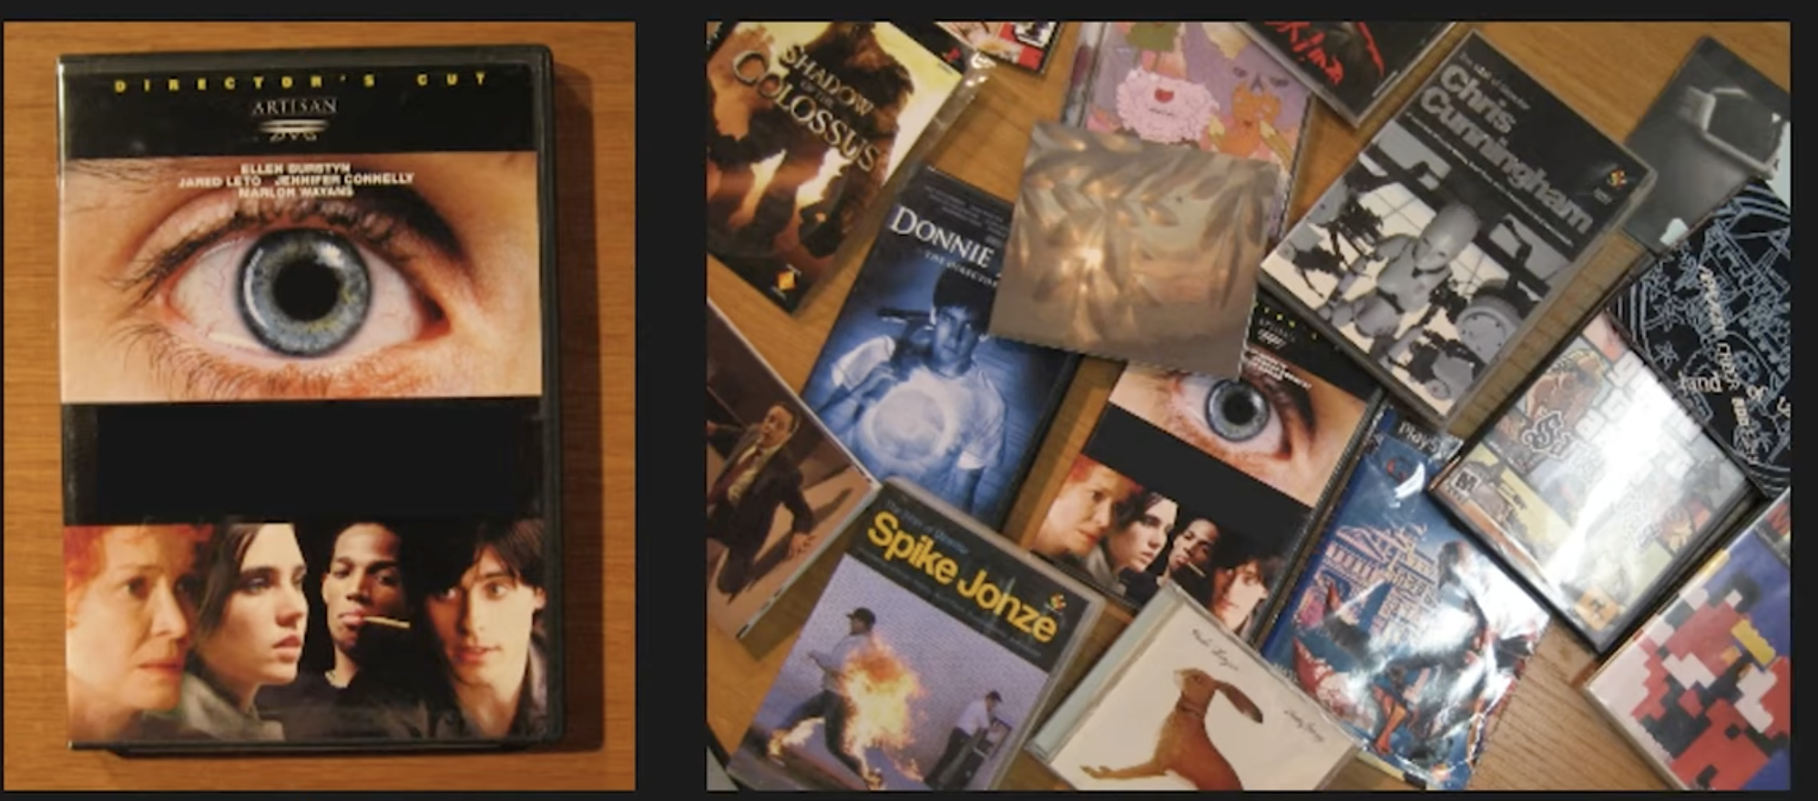
Scale-Invariant Feature Transform (SIFT)
SIFT identifies and describes local features in images. It's invariant to scaling, rotation, and partially invariant to change in illumination and 3D camera viewpoint. Detects corners ,circles, blobs etc.
Keypoints – Special points in an image that carry unique information
The SIFT (Scale-Invariant Feature Transform) algorithm is a powerful method in computer vision for detecting and describing local features in images. Here's a breakdown of its main steps:
1. Scale-space Extrema Detection
Detect potential keypoints by searching for local extrema (maxima/minima) in a series of Difference of Gaussian (DoG) images.
This is done across multiple scales (octaves) to ensure scale invariance.

Slide 16
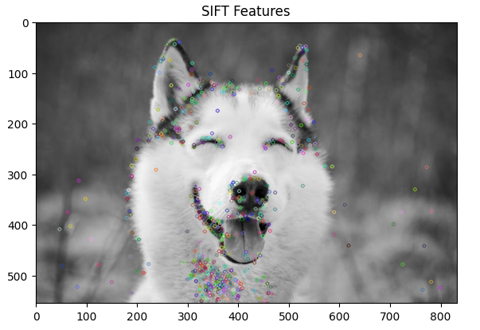
Scale-Invariant Feature Transform (SIFT)
2. Keypoint Localization
Refine the detected keypoints by:
Eliminating low-contrast points.
Removing points that lie along edges
This improves stability and accuracy.
3. Orientation Assignment
Assign one or more orientations to each keypoint based on the local image gradient directions.
This ensures rotation invariance.

Slide 17
Scale-Invariant Feature Transform (SIFT)
4. Keypoint Descriptor Generation
Around each keypoint, a region is taken and divided into smaller blocks.
For each block, a histogram of gradient orientations is computed.
These histograms are concatenated into a 128-dimensional feature vector (descriptor).
5. Feature Matching (Optional)
Descriptors from different images can be compared using distance metrics (like Euclidean distance) to find matching keypoints.

Slide 18
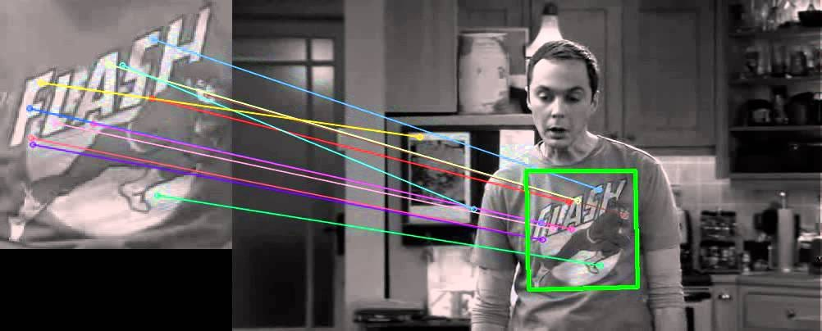
Speeded Up Robust Features (SURF)
Introduction: SURF is a faster alternative to SIFT, offering robustness to changes in scale, rotation, and illumination.
Advantages: SURF is faster due to integral images for image convolutions, uses fewer features while maintaining accuracy, and is more suitable for real-time applications.

Slide 19
Speeded Up Robust Features (SURF)
Interest Point Detection:
Uses a Hessian matrix-based detector to find keypoints.
Faster than SIFT due to use of integral images and box filters.
Scale-space Representation:
Like SIFT, SURF detects features at multiple scales.

Slide 20
Speeded Up Robust Features (SURF)
3. Orientation Assignment:
Computes Haar wavelet responses in a circular region around the keypoint.
Assigns a dominant orientation for rotation invariance.
4. Descriptor Generation:
A square region around the keypoint is divided into 4×4 subregions.
For each subregion, Haar wavelet responses in x and y directions are summed.
This results in a 64-dimensional descriptor (compared to SIFT’s 128).

Slide 21
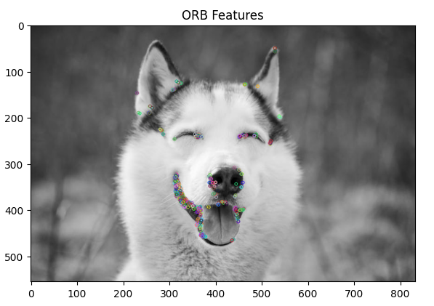
Advanced Feature Detection Techniques ORB (Oriented FAST and Roated BRIEF)
ORB is a fusion of FAST keypoint detector and BRIEF descriptor with many modifications to enhance performance.
FAST – Features from Accelerated Segment Test
BRIEF – Binary Robust Independent Elementary Features
ORB takes advantages of FAST corner detection technique to locate keypoints efficiently. Unlike traditional algorithms that use gradient information, FAST focuses on intensity changes making it robust and fast. Also, ORB employs BRIEF to generate binary descriptors for each keypoint, allowing for efficient matching.
Cv2.ORB_create() – OpenCV function for creating ORB detector with standard parameters
Deep Learning Approaches: The use of Convolutional Neural Networks (CNNs) for feature detection and description, surpassing traditional methods in accuracy and robustness.

Slide 22
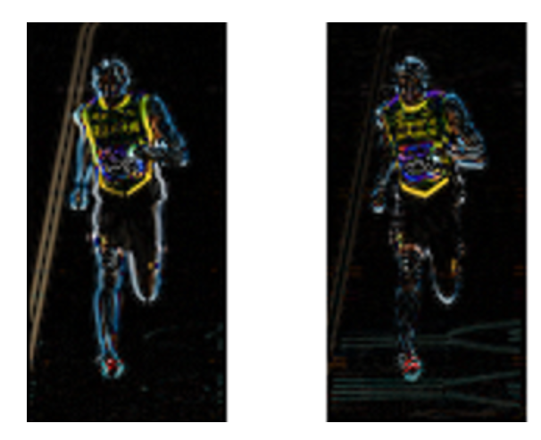
Feature Descriptors
Definition: Descriptors provide a unique and robust representation of the detected features, crucial for feature matching.
The Histogram of Oriented Gradients (HOG) is particularly effective for human detection in computer vision.
Plots image pixel orientations and gradients on a histogram – simplifies the representation of image
It works by analyzing gradients and edge directions in localized portions of an image, creating a unique representation of human shapes and postures. This makes HOG highly effective for applications like pedestrian detection in autonomous vehicles and surveillance, as it can reliably identify humans even under varying conditions.
Left : Absolute value of x-gradient. Right : Absolute value of y-gradient.

Slide 23
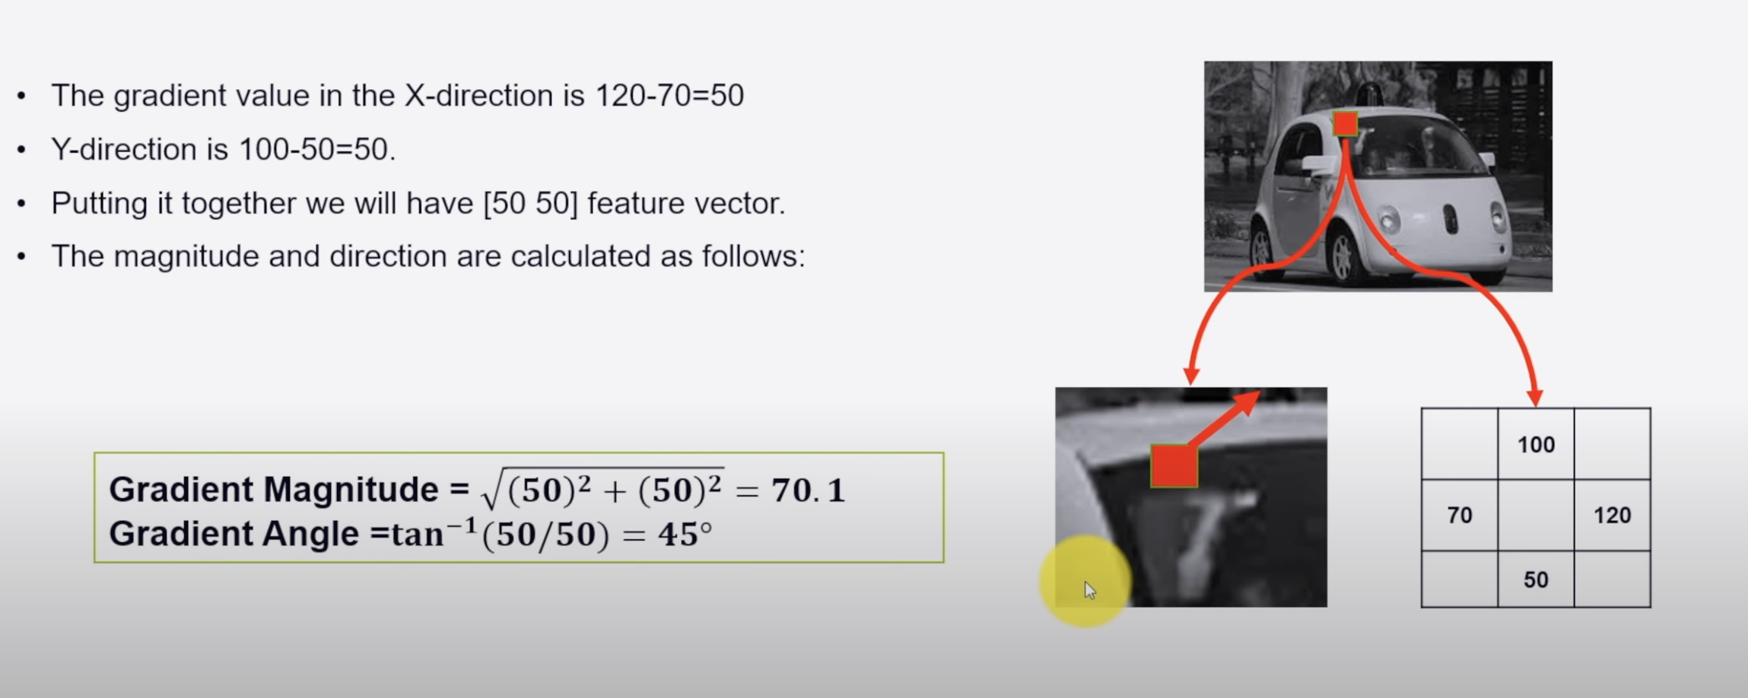
Feature Descriptors

Slide 24
Feature Matching and Applications
Feature Matching: involves identifying similar features (like edges, corners, textures) in different images. This is key for tasks where the correspondence between features in multiple images is crucial.
Compute distance between descriptors eg: Euclidian distance , Hamming distance
Find minimum distance – Brute force, Brute force KNN, FLANN –Fast Library for Approximate Nearest Neighbors
Brute-Force Matcher: Compares each feature in one set with every feature in another set, looking for the best match based on a distance metric (like Euclidean distance)
Applications: panoramic image stitching, motion tracking. object recognition, and 3D model building.

Slide 25

Machine Learning in Feature Detection
In the field of computer vision, machine learning algorithms significantly enhance feature detection by improving accuracy and efficiency. These algorithms learn from extensive data, refining the process of identifying image features.
The techniques include:
1. Supervised learning: uses labeled data for training
Eg: Email Spam detection
2. Unsupervised learning: for pattern discovery without labeled data
Eg: Customer Segmentation based on purchasing behavior
3. Semi-supervised learning: combines both approaches
Eg: Google photos

Slide 26

Real-Time Feature Detection
Real-time feature detection in computer vision faces significant challenges, particularly in balancing computational demands with the need for accuracy. In applications like video surveillance and autonomous driving, where decisions must be made swiftly and accurately, these challenges are amplified.
Common remedies:
Algorithm optimizations
Use low-level programming languages (surely not python)
Utilizes hardware acceleration (GPUs and TPUs)

Slide 27
Future Trends in Feature Detection
Deep learning, with its advanced neural networks, is enhancing the capability to automatically and accurately detect features in images by learning complex patterns in large datasets.
This approach is a departure from traditional methods that relied on handcrafted algorithms and is proving to be more effective in handling the nuances and variability in real-world images.
Enabling smarter feature detection systems that can adapt and improve over time, learning from new data and experiences

Slide 28
Next Week
Introduction to CNN
Architecture of CNN
How CNN resolves common computer vision problems

